Slide 1
Software Cost Estimation - COCOMO
proposed by Boehm.

Slide 2
COCOMO
COCOMO stands for COnstructive COst MOdel
A method for modeling software development to yield estimates of project effort and cost before undertaking the project
• Based on a mathematical model of effort plus empirical constants to parameterize the model

Slide 3
COCOMO Models
COCOMO is defined in terms of three different models:
the Basic model,
the Intermediate model, and
the Detailed model.
The more complex models account for more factors that influence software projects, and make more accurate estimates.

Slide 4
COCOMO (cont..)
Boehm postulated that any software development project can be classified into one of the following three categories based on the development complexity:
Organic,
Semidetached and
Embedded.

Slide 5
COCOMO (cont..)
Organic:
A development project can be considered of organic type, if the project;
Is developed in a familiar, stable environment.
Deals with developing a well understood application program,
The size of the development team is reasonably small.
The product is also relatively small and requires little innovation.
The team members are experienced in developing similar types of projects and the product is similar to previously developed products.

Slide 6
COCOMO (cont..)
Semidetached:
A development project can be considered of semidetached type,
If the development consists of a mixture of experienced and inexperienced staff.
Team members may have limited experience on related systems but may be unfamiliar with some aspects of the system being developed.
The project's characteristics are intermediate between Organic and Embedded.

Slide 7
COCOMO (cont..)
Embedded:
A development project is considered to be of embedded type,
The project is characterized by tight, inflexible constraints and interface requirements.
If the software being developed is strongly coupled to complex hardware, or if the stringent regulations on the operational procedures exist.
An embedded mode project will require a great deal of innovation.

Slide 8
COCOMO (cont..)
Organic
2-50 KLOC, small, stable, little innovation
Semi-detached
50-300 KLOC, medium-sized, average abilities, medium time-constraints
Embedded
> 300 KLOC, large project team, complex, innovative, severe constraints

Slide 9


Where
• KLOC is the estimated size of the software product expressed in Kilo Lines of Code,
• a1, a2, b1, b2 are constants for each category of software products,
• Tdev is the estimated time to develop the software, expressed in months,
• Effort is the total effort required to develop the software product, expressed in person months (PMs).

Slide 10
The Constants for “Effort”
Mode | a1 | a2
Organic | 2.4 | 1.05
Semi-detached | 3.0 | 1.12
Embedded | 3.6 | 1.20

Slide 11
The Constants for “Tdev”
Mode | b1 | b2
Organic | 2.5 | 0.38
Semi-detached | 2.5 | 0.35
Embedded | 2.5 | 0.32

Slide 12
Development Effort Estimation
Organic :
Effort = 2.4 (KLOC)^{1.05} PM
Semi-detached:
Effort = 3.0(KLOC)^{1.12} PM
Embedded:
Effort = 3.6 (KLOC)^{1.20}PM

Slide 13
Development Time Estimation
Organic:
Tdev = 2.5 (Effort)^{0.38} Months
Semi-detached:
Tdev = 2.5 (Effort)^{0.35} Months
Embedded:
Tdev = 2.5 (Effort)^{0.32} Months

Slide 14
Example
The size of an organic software product has been estimated to be 32,000 lines of source code.
Effort = 2.4*(32)^{1.05} = 91 PM
Nominal development time = 2.5*(91)^{0.38} = 14 months

Slide 17
Average Staff Size

Slide 18
Productivity

Slide 19
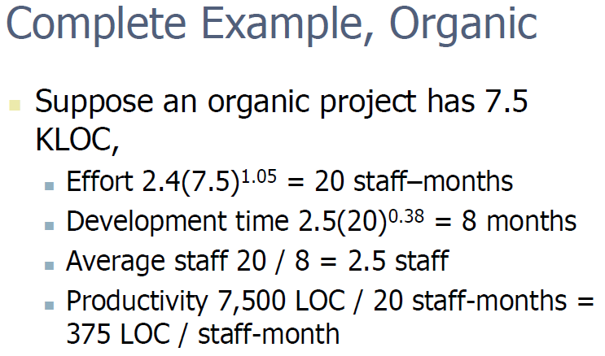

Slide 20
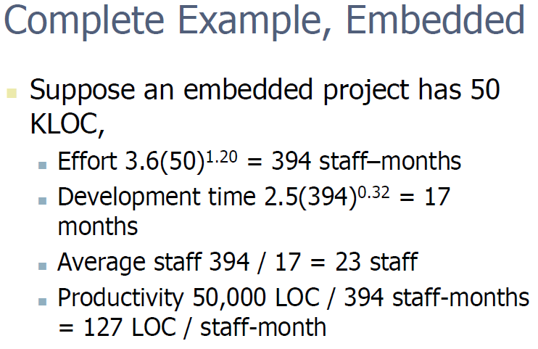

Slide 21
Intermediate COCOMO
Basic COCOMO model assumes
effort and development time depend on product size alone.
However, several parameters affect effort and development time:
Reliability requirements
Availability of CASE tools and modern facilities to the developers
Size of data to be handled

Slide 22
Intermediate COCOMO (cont.)
For accurate estimation,
the effect of all relevant parameters must be considered:
Intermediate COCOMO model recognizes this fact:
refines the initial estimate obtained by the basic COCOMO by using a set of 15 cost drivers (multipliers).

Slide 23
Intermediate COCOMO (cont.)
Cost driver classes:
Product: Inherent complexity of the product, reliability requirements of the product, etc.
Computer: Execution time, storage requirements, etc.
Personnel: Experience of personnel, etc.
Development Environment: Sophistication of the tools used for software development.

Slide 24
Intermediate COCOMO (cont.)

Slide 25
Intermediate COCOMO (cont.)
Categories of driver classes
Product Attributes
Computer Attributes
Personnel Attributes
Project Attributes

Slide 26
Intermediate COCOMO (cont.)
I. Product Attributes
Product: The characteristics of the product that are considered include.
RELY - Required Software Reliability (1.00)
DATA - Data Base Size (0.94)
CPLX - Product Complexity (1.30)

Slide 27
Intermediate COCOMO (cont.)
II. Computer Attributes
Computer: Characteristics of the computer that are considered include the execution speed required, storage space required etc.
TIME - Execution Time Constraint
STOR - Main Storage Constraint
VIRT - Virtual Machine Volatility1
TURN - Computer Turnaround Time

Slide 28
Intermediate COCOMO (cont.)
III. Personnel Attributes
Personnel: The attributes of development personnel that are considered include the experience level of personnel, programming capability, analysis capability, etc.
ACAP - Analyst Capability
AEXP - Application Experience
PCAP - Programming Capability
VEXP - Virtual Machine Experience1
LEXP - Programming Language Experience

Slide 29
Intermediate COCOMO (cont.)
IV. Project Attributes
Development Environment: Development environment attributes capture the development facilities available to the developers. An important parameter that is considered is the sophistication of the automation (CASE) tools used for software development.
MODP - Modern Programming Practices
TOOL - Use of Software Tools
SCED - Required Development Schedule

Slide 31
Complete COCOMO model
Both models: (Basic & Intermediate)
consider a software product as a single homogeneous entity:
However, most large systems are made up of several smaller sub-systems.
Some sub-systems may be considered as organic type, some may be considered embedded, etc.
for some the reliability requirements may be high, and so on.

Slide 32
Complete COCOMO model (cont..)
Cost of each sub-system is estimated separately.
Costs of the sub-systems are added to obtain total cost.
Reduces the margin of error in the final estimate.

Slide 33
Complete COCOMO Example
A Management Information System (MIS) for an organization having offices at several places across the country:
Database part (semi-detached)
Graphical User Interface (GUI) part (organic)
Communication part (embedded)
Costs of the components are estimated separately:
summed up to give the overall cost of the system.

Slide 34
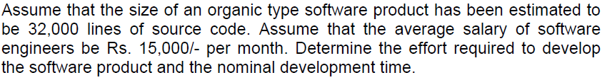


Slide 35
Drawbacks
COCOMO has to be calibrated to your environment.
Very sensitive to change.
Over a person-year difference in a 10 KLOC project with minor adjustments
Broad brush model that can generate significant errors

Slide 36
COCOMO Summary
Quick and easy to use
Provides a reasonable estimate
Needs to be calibrated
Results must be treated as ball park values unless substantial validation has been performed.

